Slide 1
Android PDF Viewer
An Android Application Project

Slide 2
Project Supervisor:
Presented By:
Supriyo Talukder Id: 1712020103
Mohi Uddin Pabel Id: 1712020128
Arafat Habib Quraishi
Senior Lecturer
Department of CSE
Leading University, Sylhet
2

Slide 3
Contents
Introduction & Background.
Importance and needs of Android PDF Viewer.
Features.
Tech Used in Making.
System Requirements.
Diagrams.
Snapshots of the app.
Conclusion.
Future work.

Slide 4
Introduction and Background
PDF was developed by Adobe.
Was not that much reliable for phones.
We created an Android Application.
It’s Faster.
Much reliable.
Has other features.

Slide 5
Importance and Needs of A.P.V.
User friendly interface.
Reduce the content loading time.
People of almost all age can use it.
Anywhere it can be used.

Slide 6
Features
Has multiple functionality.
Works faster.
Can create PDF files.
Converts other files to PDF.

Slide 7
Tech Used in Making
Device:
PC: Windows 10
Phone: Android 6.0
GUI Design:
XML (Android Studio)
Adobe Photoshop
Adobe Illustrator
Software:
Android Studio
Java Development Kit (JDK)
Programming Language:
Java

Slide 8
System Requirements
Platform: Android.
Version: Android 5.0 or above.
RAM: 512MB or above.
ROM: 30MB

Slide 9
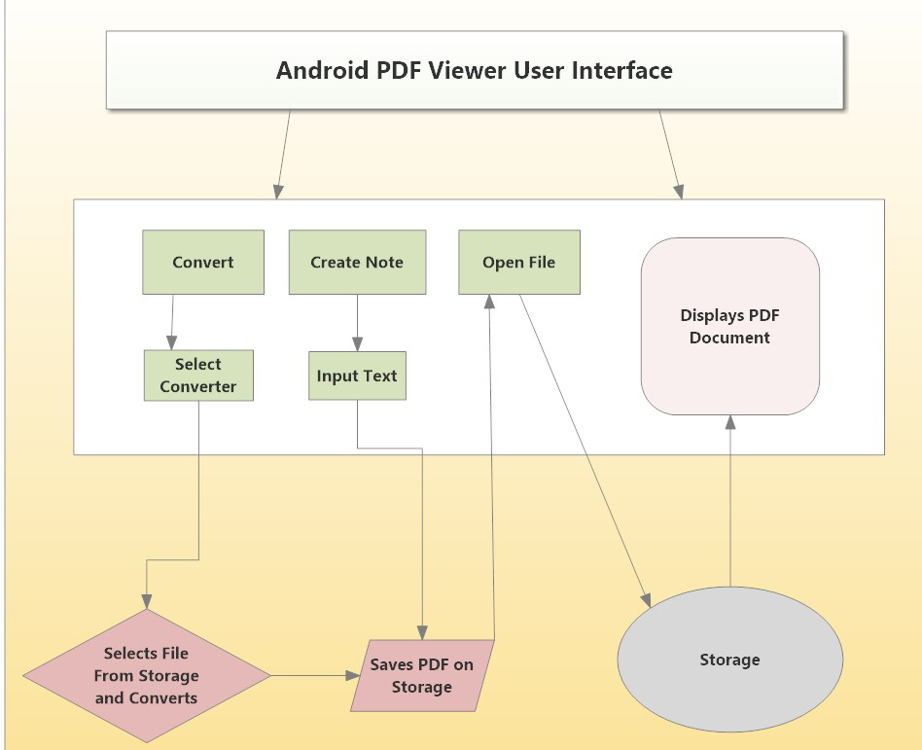
Diagrams
System Architecture:

Slide 10
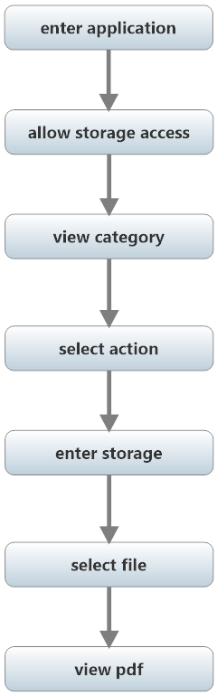
Diagrams 2
Activity Diagram:

Slide 11
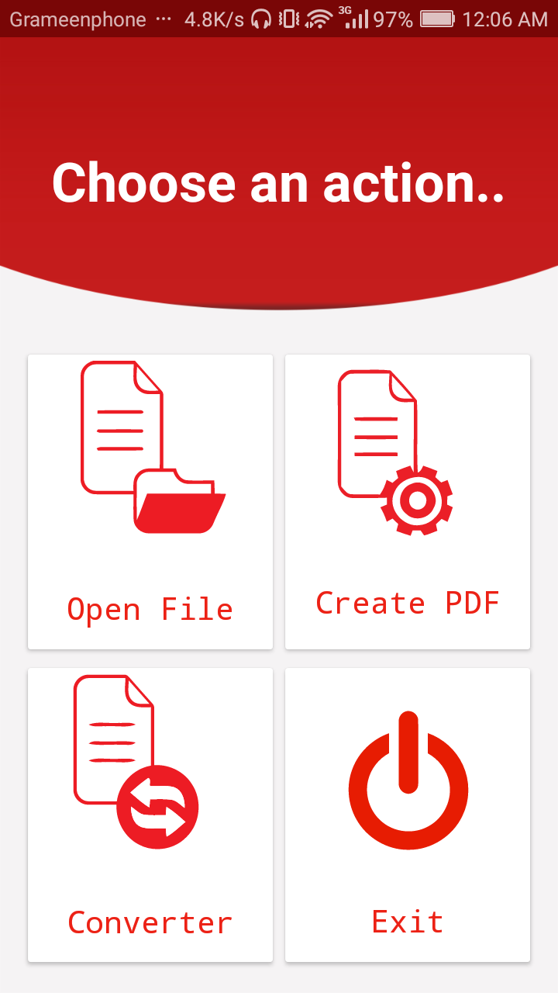
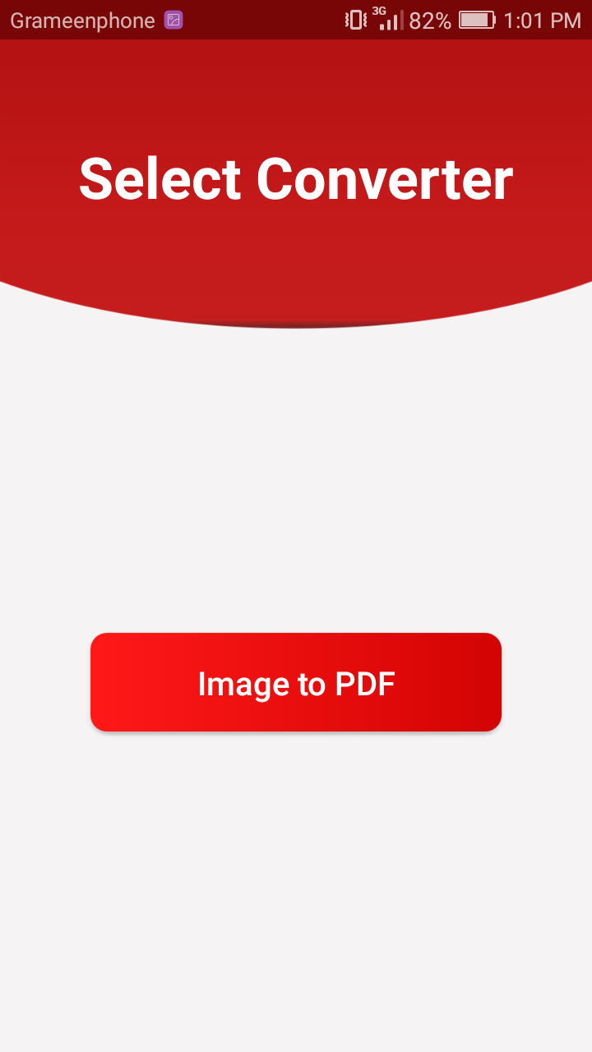
Snapshots of the app

Slide 12
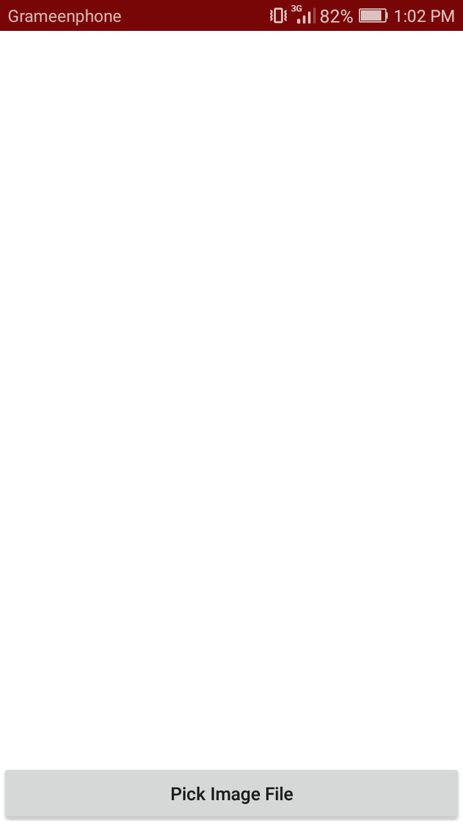
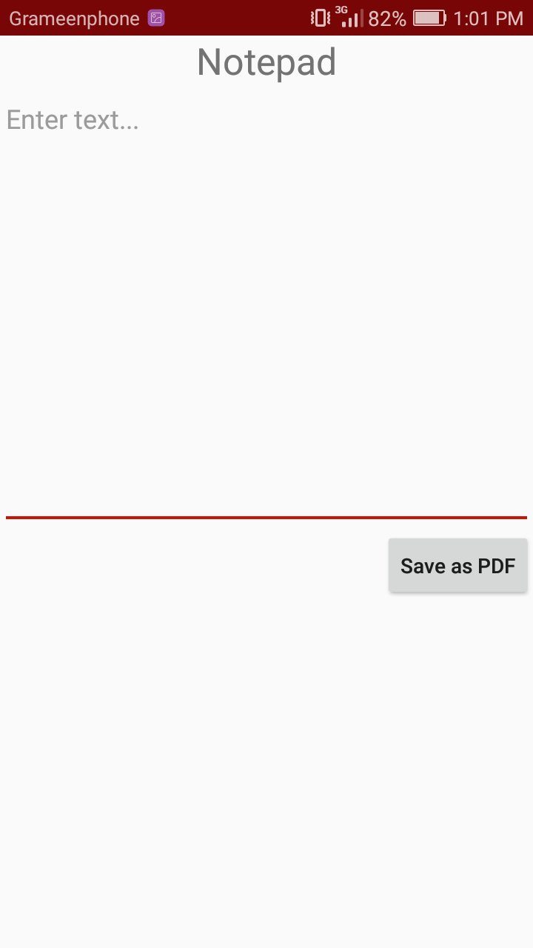
Snapshots of the app 2

Slide 13
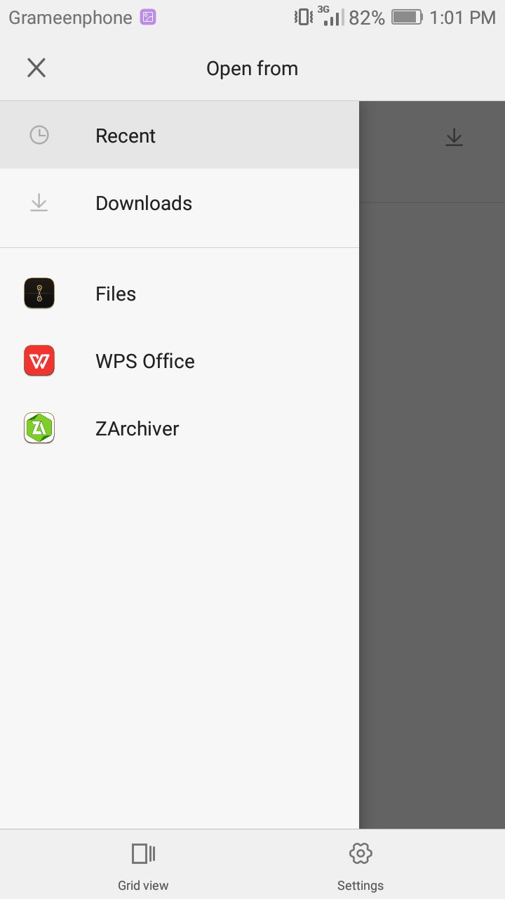
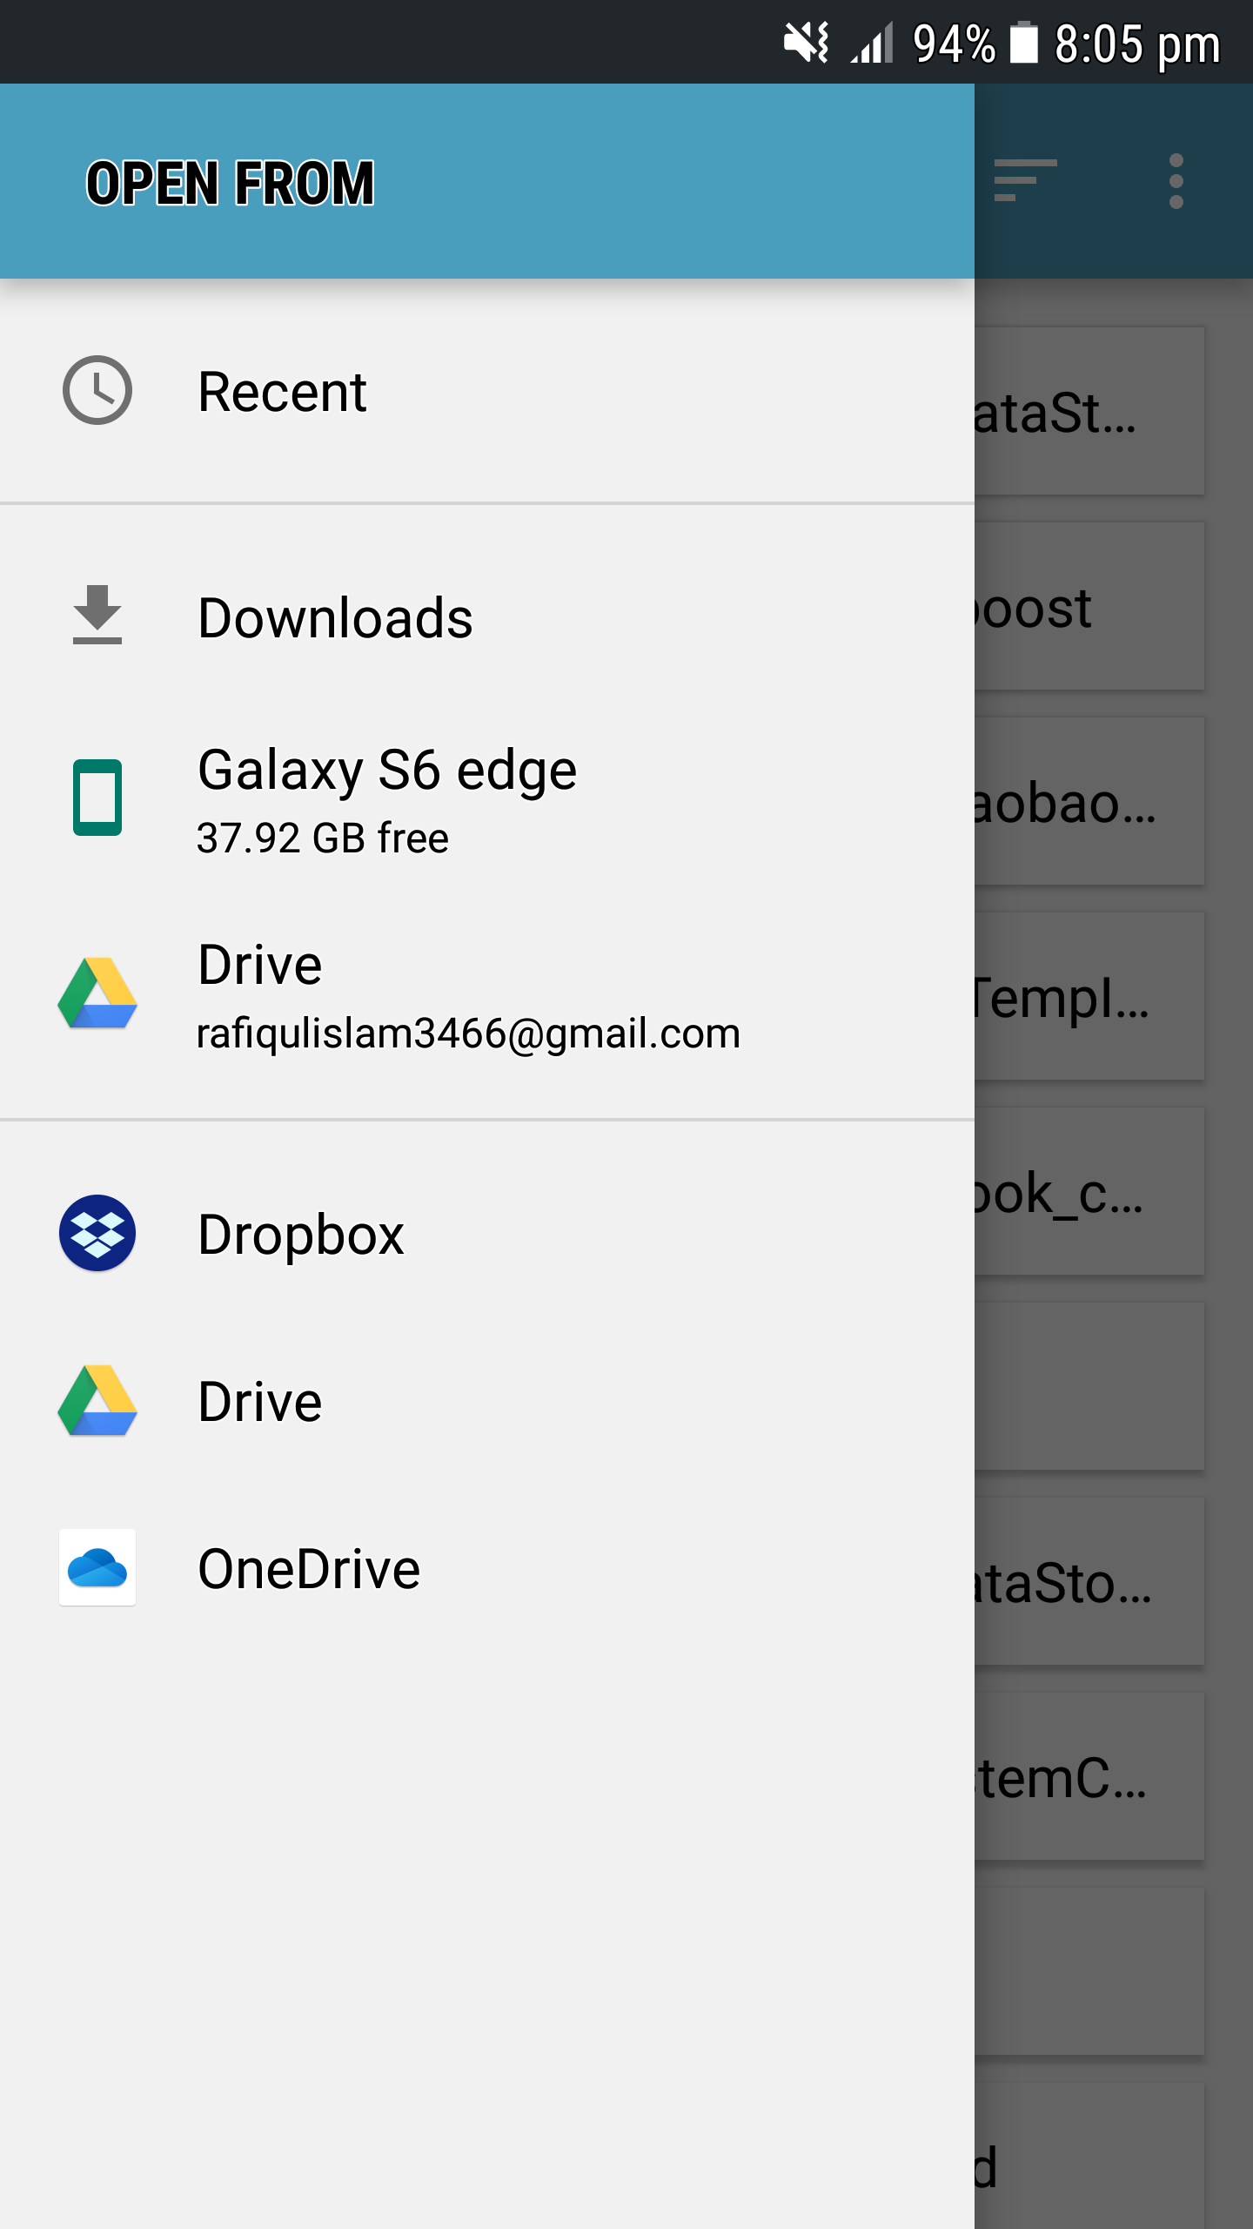
Snapshots of the app 3
API 23 
API 24 

Slide 14
Conclusion
The project deals with PDF.
Main Objective.
Has limitations.

Slide 15
Future Work
Make it more reliable.
Improve the features.
Add more features.

Slide 16
The expert in anything was once a beginner.” - Helen Hayes

Slide 17
Thank You

